Slide 1
Your Face Never Lies
You Are All Sanpaku
© 2008 Phiya Kushi
This presentation is for educational purposes only and may contain unauthorized copyrighted material.
Claims of unauthorized use of copyrighted material are the responsibility of the presenter and should be promptly removed.

Slide 2
This presentation is dedicated to…

Slide 3
William Dufty (1916-2002), author of “You Are All Sanpaku” with George Ohsawa

Slide 5
It all began one sunny day…

Slide 6
November 22, 1963
Dallas, Texas

Slide 12
Three Months Before…

Slide 14
An article appeared in:
On August 18, 1963
written by:

Slide 15
Tom Wolfe, journalist, writer, author
He interviewed a curious Japanese philosopher:

Slide 16
George Ohsawa, the founder of modern macrobiotics

Slide 17
The article was titled:
Kennedy To Bardot:
Too Much Sanpaku

Slide 18
After Kennedy’s death
Tom Wolfe revisited Ohsawa and
wrote a second article on January 12, 1964

Slide 19
January 12, 1964 - New York Herald Tribune
Sanpaku On Second Avenue
Abdul Karim Kassem, President Ngo Dinh Diem
and President Kennedy; all sanpaku and,
now, all shot to death, all destroyed by the fate
of the sanpaku, which is more than a coincidence
and should be an alarm signal to men and nations,
say the Macrobiotics, for thus it has been demon-
strated by their leader, George Ohsawa, Japanese
Prophet of the Unique Principle.

Slide 20
Abdul Karim Kassem, ruler of Iraq, shot and killed, February 9 1963

Slide 21
Ngo Dinh Diem, President of South Vietnam, shot and killed, November 2 1963

Slide 22
President John F. Kennedy, shot and killed, November 22 1963

Slide 23
So what exactly is SANPAKU???

Slide 24
Sanpaku (sa – nm – PAH - koo) eyeball/iris comparative analysis
“San” is Japanese for “three” and “paku” is Japanese for “white”.
“Sanpaku” eyes describes a condition where one is able to see three whites surrounding the iris when the person is looking forward straight.

Slide 25
Three basic eyeball/iris conditions
Ue-Sanpaku
upper 3 whites
2. Normal
Sanpaku
lower 3 whites

Slide 26
Three basic eyeball/iris conditions
Ue-Sanpaku – (pronounced “ooWAY-sa-nnm-PAH-koo”) – “upper” Sanpaku - found naturally in newborn babies. The whites of the eyes are visible on the sides and upper portion of the eye. Adults with this condition are severely mentally troubled.

Slide 27
Normal Eyes
Normal Eyes – The white of eyes are only visible on two sides of the iris. This is the normal and healthy condition for anyone from birth to old age.

Slide 28
Sanpaku Eyes
Sanpaku Eyes – The white of eyes are visible on three sides of the iris (sides and lower portion). This is the normal at very old ages nearing natural death (90 years or older). But is abnormal for anyone younger and indicates an extremely unhealthy condition and possible premature death

Slide 29
Baby with Upper Sanpaku

Slide 30
Person with normal eyes

Slide 31
Old man (112yo) with Sanpaku Eyes

Slide 32
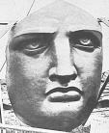
Examples of Sanpaku Eyes Indicating Tragic - Premature Death
Very Sanpaku
Near Sanpaku
Upper Sanpaku
1.
4.
7.
Bonus eyes A & B
2.
5.
A.
3.
6.
B.

Slide 33
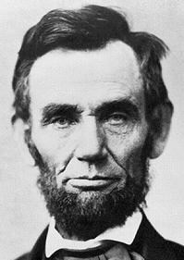
Very Sanpaku Eye #1
Whose eye is this?
Abraham Lincoln assassinated at age 56

Slide 34
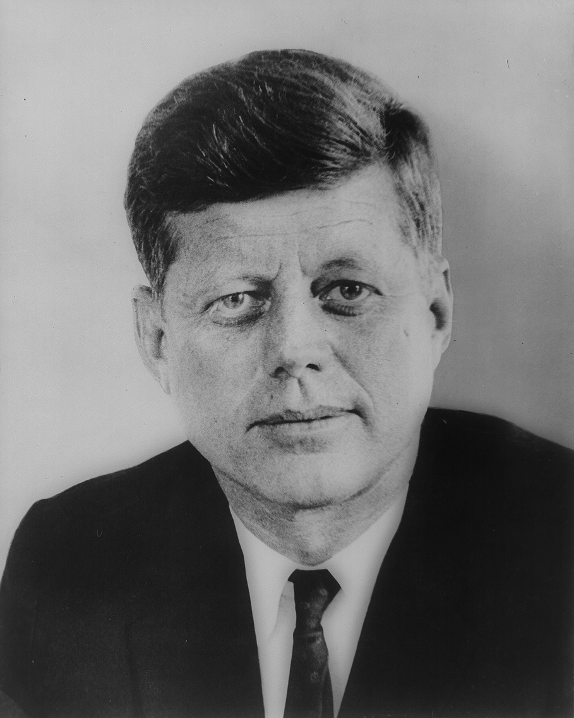
Very Sanpaku Eye #2
Whose eye is this?
John F. Kennedy
assassinated at age 46

Slide 35
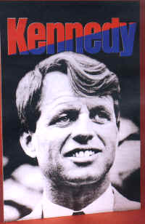
Very Sanpaku Eye #3
Whose eye is this?
Robert F. Kennedy
assassinated at age 43

Slide 36
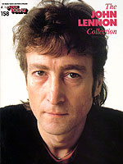
Near Sanpaku Eye #4
Whose eye is this?
John Lennon, killed at age 40

Slide 37
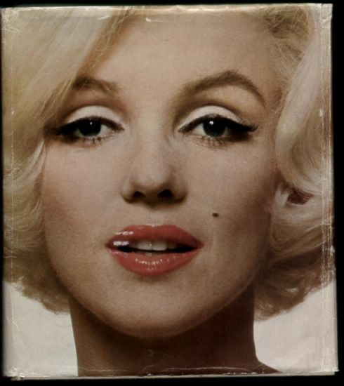
Near Sanpaku Eye #5
Whose eye is this?
Marilyn Monroe, died at age 36

Slide 38
Near Sanpaku Eye #6
Whose eye is this?
Elvis Presley, died at age 42

Slide 39
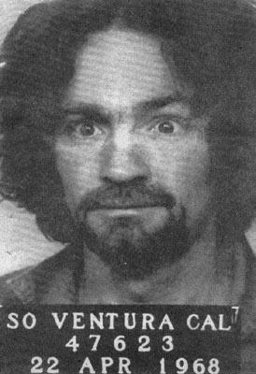
Upper Sanpaku Eye #7
Whose eye is this?
Charles Manson, still alive

Slide 40
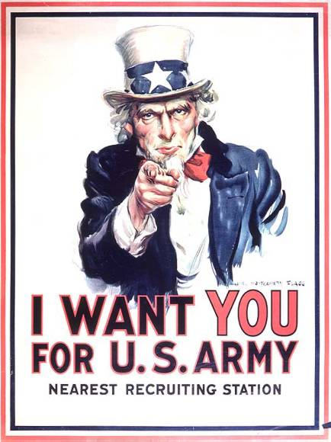
Bonus Eye #A
Whose eye is this?
Uncle Sam

Slide 41
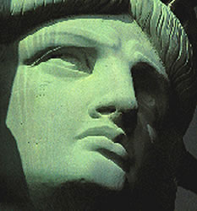
Bonus Eyes #B
Whose face is this?
Miss Liberty – The eyes of our nation’s symbols are sanpaku

Slide 42
One more…
Actor Heath Ledger, 28, died January 22, 2008

Slide 43
And should we worry about the person who has this eye?

Slide 44
The Million Dollar Question:

Slide 45
Why and how does this work?

Slide 46
We must first understand the difference between our:
Constitution and
Condition

Slide 47
OUR CONSTITUTION
Our constitution is everything that we were born with. It is who were are at the time of our birth. This includes our physical structure, size and the context of our life.
OUR CONDITION
Our condition is everything that happens to us after we’re born. This includes our health, our disposition and the quality of our life.

Slide 48
What determines our constitution?

Slide 49
Things that determine our constitution:
The Universe itself; its shape, structure and how it behaves
The Earth and its movements
Life on earth and how humans came to be – our ancestry
Our own embryological development

Slide 50
About the Universe:
The shape of our UNIVERSE
How the UNIVERSE moves and changes
How it relates to us

Slide 51
What is the shape of the UNIVERSE?

Slide 60
The shape of the UNIVERSE (and everything in it including ourselves) is basically a SPIRAL!!!

Slide 61
Can you identify some spirals in your body?

Slide 62
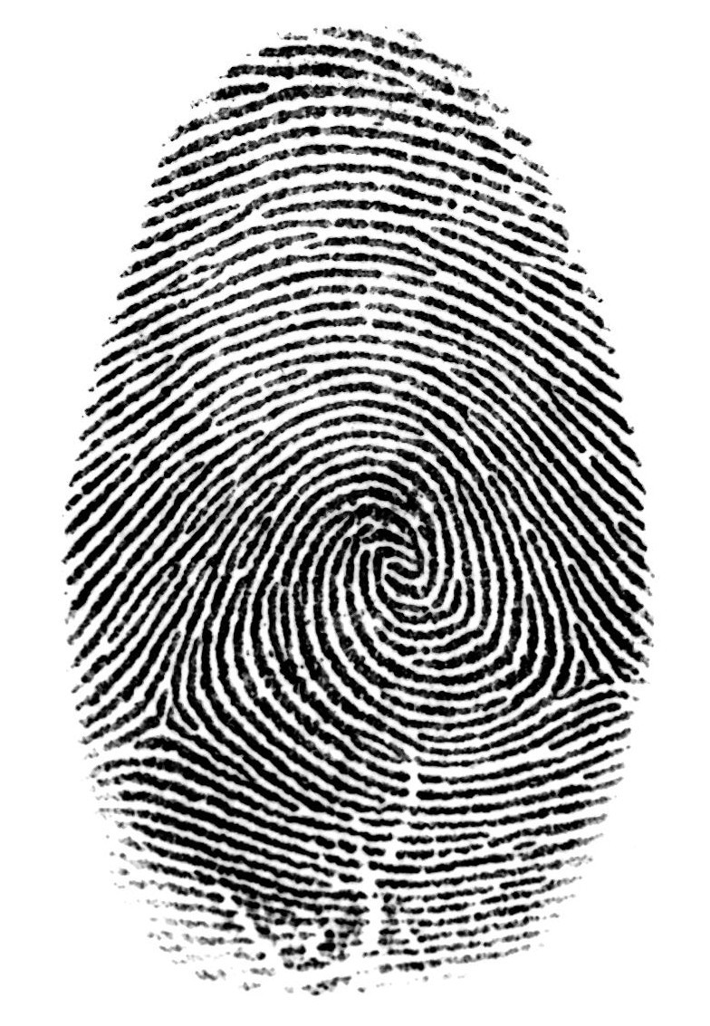
Spirals in fingerprints

Slide 63
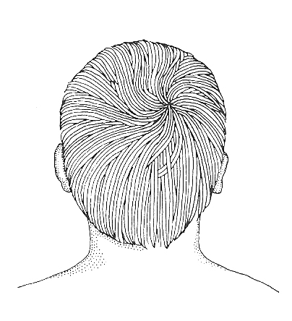
The spiral on top of your head

Slide 64
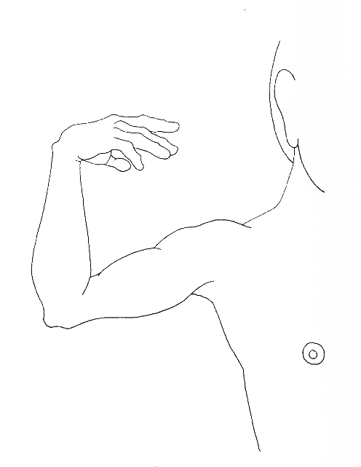
The spiral of your hand and arm

Slide 65
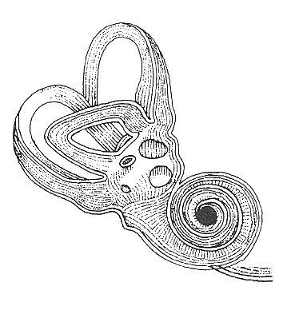
The spiral of your inner ear

Slide 66
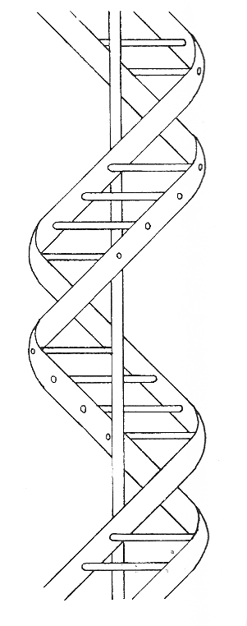
The spiral of your DNA

Slide 67
How do spirals move and behave?
They expand and contract
The have Fractal Dimensions
They oscillate back and forth in orbits or waves

Slide 68
Expanding and Contracting Spirals (1)
YIN
YANG
The periphery becomes the center and vice versa

Slide 69
Expanding and Contracting Spiral (2)

Slide 70
Spirals have Fractal Dimension The whole is mirrored in its parts and vice versa

Slide 71
The “Mandelbrot” Fractal Set (zoom in animation)

Slide 72
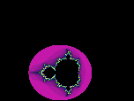

Slide 73
Wave motion of spirals

Slide 74
Spirals - Summary
Expansion and Contraction (yin and yang)
The periphery becomes and center and center becomes the periphery (yin becomes yang and yang becomes yin)
Inside - Outside
Front - Back
Top – Bottom (up and down)
All opposites are complementary and have direct correlation with each other

Slide 75
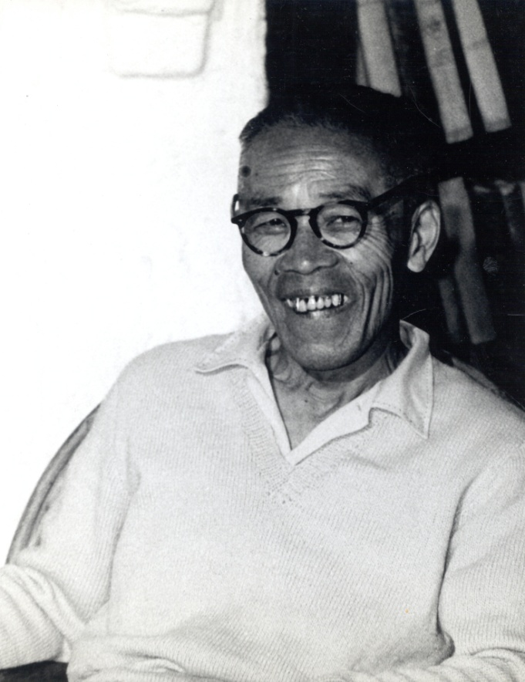
George Ohsawa called these observations of the Universe the “Unifying Principle”
He also called it the “magic spectacles” or “Aladdin’s Lamp” or
The “treasure of all treasures”

Slide 76
Things that determine our constitution:
X
The Universe itself; its shape, structure and how it behaves
The Earth and its movements
Life on earth and how humans came to be
Our own embryological development

Slide 77
The five movements of the Earth
The movement of the galaxy (600 km/s)
The orbit of the solar system around the galaxy (1 galactic year – 220 km/s)
The orbit around the sun (29.78 km/s)
Rotation of the earth (465 m/s)
Precession of the Equinoxes (one orbit take 25,700 years)

Slide 78
1. Movement of our galaxy through space
Our galaxy is thought to be moving through space at the rate of 600 km/s
That means that Earth is traveling at 51.84 million km per day, or more than 18.9 billion km per year, about 4.5 times its closest distance from Pluto.
The galaxy is thought to be moving toward the constellation Hydra

Slide 79
The Milky Way

Slide 80
The Milky Way Galaxy: Our Home
Expansive (yin) motion
Contractive (yang) motion
Being a spiral, it has contractive and expansive motion

Slide 81
2. The orbit of our solar system around the Milky Way galaxy
The Contractive (yang) motion keeps everything moving toward the center
It takes our solar system about 250 million years to travel around the galaxy.
The sun has made 20~25 orbits around the galaxy in its life.
Humans supposedly have only been around for 1/1250 of an orbit.
While the rotation, orbit and the center creates an expansive (yin) motion outward

Slide 82
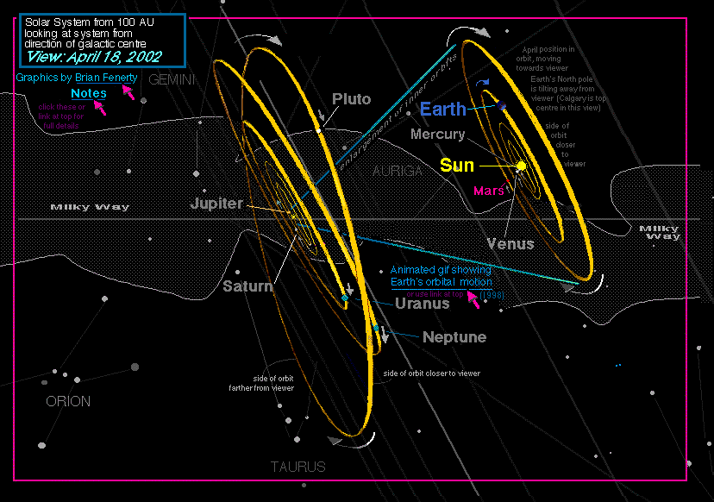
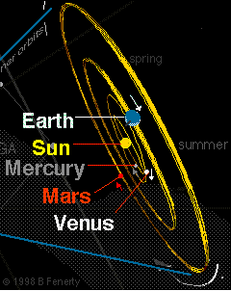
View of our solar system from the galactic center The solar system is thought to be almost perpendicular to Milky Way
The motion of the planets around the solar system while it moves
around the galaxy forms spiraling waves

Slide 83
3. Earth around the Solar System
The contractive forces keeps the planets in their orbit
Expansive forces are generated by revolution, rotation and the sun

Slide 84
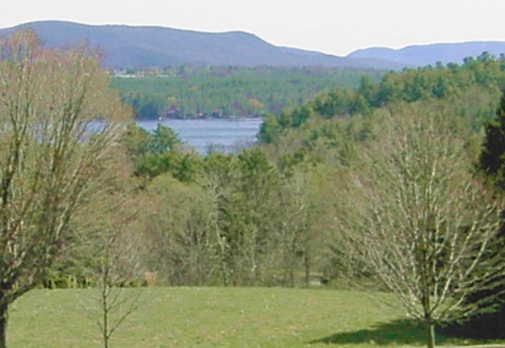
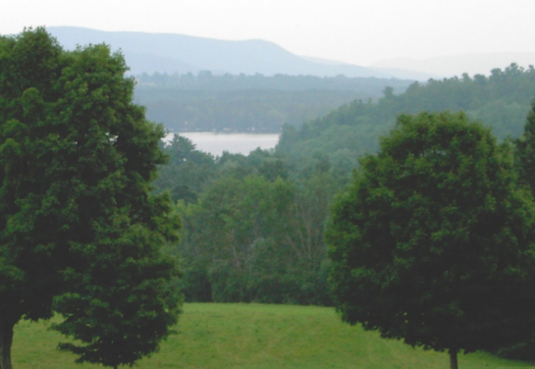
Earth’s orbit around the sun creates the seasons

Slide 85
Earth passes through the seasons of the year and the constellations of the zodiac
(This cycle corresponds to the acupuncture meridians and the development of organs)

Slide 86
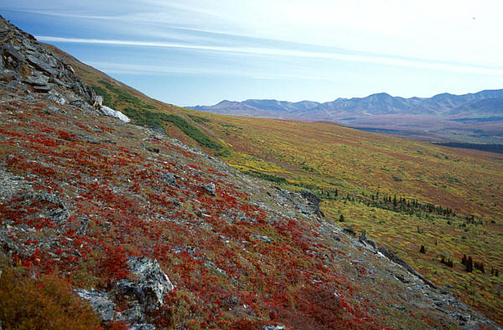
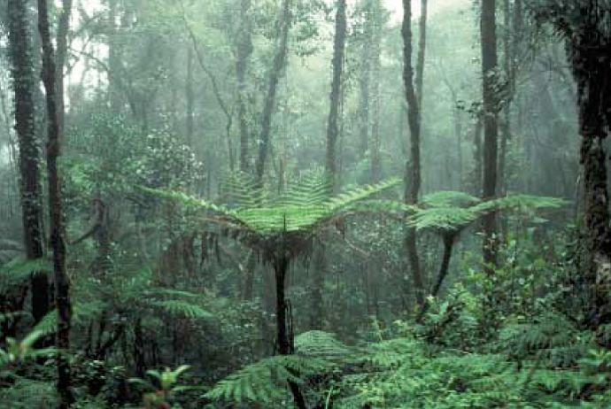
4. Earth’s Rotation
Equatorial Rainforest – high growth dense vegetation
Contractive forces helped form the Earth and are strongest at the poles
Expansive forces are generated by rotation and are strongest at the equator
Artic Tundra low growth vegetation

Slide 87
5. Precession Of The Equinoxes
We’ll skip this one for this presentation

Slide 88
Summary of Earth movements
Movement of the Galaxy
Orbit of the Solar System around the Galaxy
Orbit of Earth around the sun
Rotation of the Earth

Slide 89
The combination of all movements of the Earth creates a curious effect on the earth’s magnetosphere normally drawn like this:
Solar wind
magnetosphere
But this image is not complete

Slide 90
But when you add the influences of all the movements it can look like this:

Slide 91
Things that determine our constitution:
X
The Universe itself; its shape, structure and how it behaves
The Earth and its movements
Biological development on earth
Our own embryological development
X

Slide 92
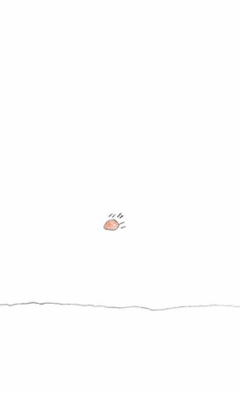
The four movements make up the primary forces that determine the spiral motion and growth that happen on Earth.
Direction of growth

Slide 93
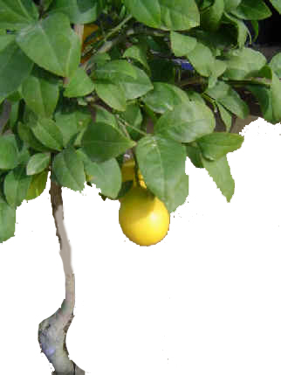
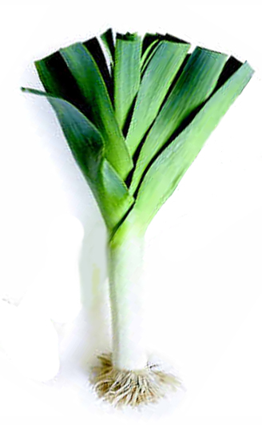
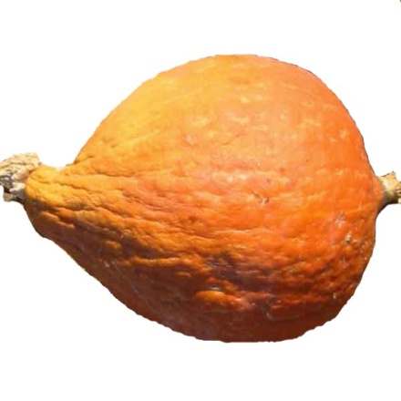
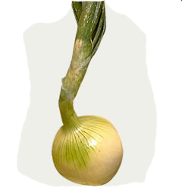
In this way plants can be classified according to their contractive (yang) and expansive (yin) properties
Expansive
More Yin
Contractive
More Yang
Squash
Onion
Lemon
Leek
Carrot
Toward the center of the Earth

Slide 94
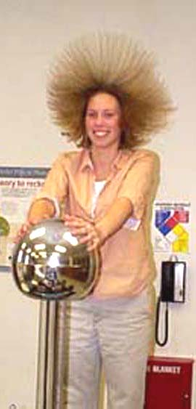
Plants grow upward;
Expanding away from
the center of the Earth
Animals and plants are opposite in growth and structure…
Direction of growth

Slide 95
The human form has a 7:1 ratio
Humans and animals grow downward toward the Earth
Direction of growth

Slide 96
Human teeth - plant to animal food ratio: 28 Incisors and molars to 4 Canines (7:1)
To maintain our balance we eat a ratio of 7 plant to 1 animal food
(the opposite of what we are structurally)

Slide 97
Biological Development On Earth (water period 2.8 billion years – land period 0.4 billion years 7:1)
More expanisve
More contractive

Slide 98
Humans are the end point of a 7 orbit spiral

Slide 99
Things that determine our constitution:
X
The Universe itself; its shape, structure and how it behaves
The Earth and its movements
Biological development on earth
Our own embryological development
X
X

Slide 100
Embryological comparisons Our embryo goes through all animal life form development
The 9 months gestation period of a human is a replica of
The 2.8 billions years of biological development in the ocean

Slide 101
Development of the three major systems

Slide 102
Development of the three major systems

Slide 103
The three systems in the ear

Slide 104
The three systems in the hand

Slide 105
The three systems in the face

Slide 106
Embryological development of the three systems corresponding to the face

Slide 107
Head shape according to birth (gestation period – northern hemisphere)

Slide 108
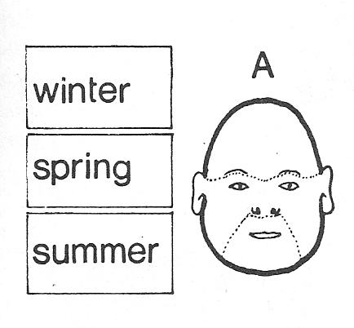
Head shape type A (born in summer)
Jim Belushi – June 15
Ice Cube – June 15

Slide 109
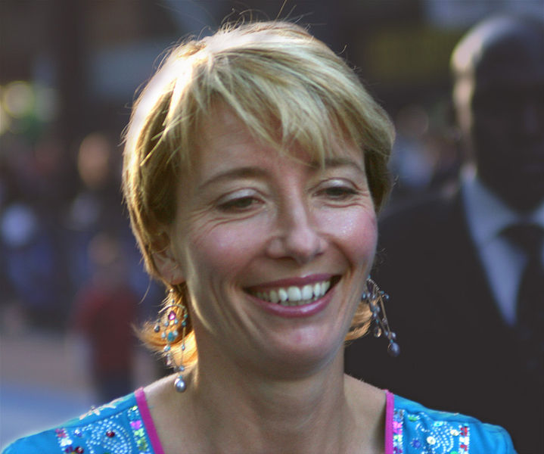
Head shape type B (born in spring)
Emma Thompson – April 15
Emma Watson – April 15

Slide 110
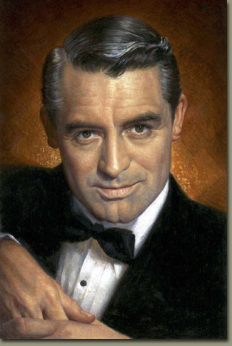
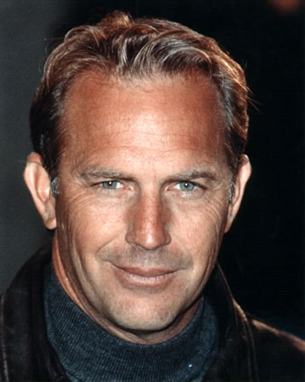
Head shape type C (born in winter)
Cary Grant - Jan 18
Kevin Costner – Jan 18

Slide 111
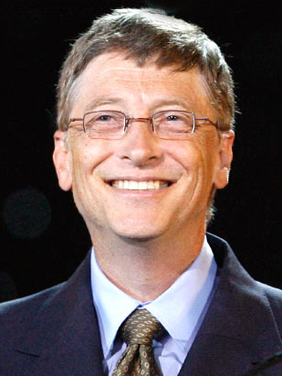
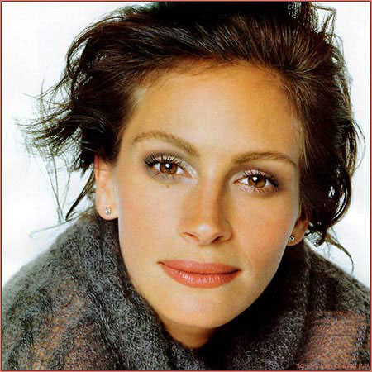
Head shape type D (born in fall)
Bill Gates – Oct 28
Julie Roberts – Oct 28

Slide 112
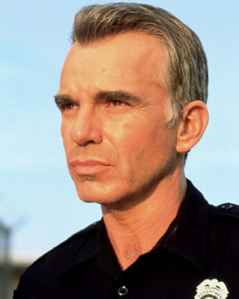
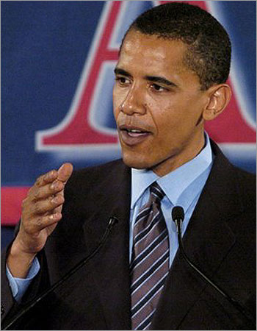
One more
Billy Bob Thorton – August 4
Barack Obama – August 4

Slide 113
Embryological comparisons Our embryo goes through all animal life form development
The 9 months gestation period of a human is a replica of
The 2.8 billions years of biological development in the ocean

Slide 114
Embryo facial development

Slide 115
Deformations

Slide 116
Things that determine our constitution:
X
The Universe itself; its shape, structure and how it behaves
The Earth and its movements
Biological development on earth
Our own embryological development
X
X
X
What the mother eats during pregnancy is the most
crucial factor in creating a healthy constitution.

Slide 117
How to see our condition:

Slide 118
First, a lesson in biology:
lungs
lungs
heart
kidneys
kidneys
liver
stomach
small intestines
large intestines

Slide 119
Internal organs and face correlations
bladder
small
intestines
liver
kidneys
kidneys
heart
lungs
lungs

Slide 121
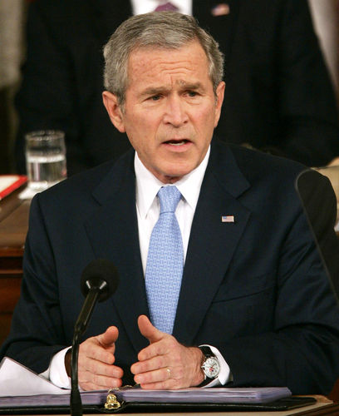
What do you see in this man’s face?
Is he SANPAKU?
In what season was he born?
What about his forehead?
What about the bags under his eyes?
What about the lines between his eyebrows
How about his lips?
How about the redness of his skin complexion?
Is there anything else?

Slide 122
About George W. Bush:
He is a little Sanpaku.
He was born in summer. (July 6)
Too much fluid in intestines
Kidneys are swollen, (especially the left one)
His liver is congested
His lower intestines are swollen, His stomach is too tight.
He has high blood pressure

Slide 123
Your Face Never Lies – the book

Slide 124
Thank you!

